Slide 1

Meeting Week 3
Dynamic equivalency and peer grouping using Factor Modeling and Machine Learning
6/25/2019

Slide 2


Dealing with missing values
Technical
Features
23 stocks that have missing values.
Drop these 23 stocks
(1008)
Unbalanced
Orders Dataset
1. Drop the same 23 stocks in technical features
2. Impute mean to the rest of missing values
Fundamental
Features
Dynamic-Adjust System:
1. Adjust our quotations based on net position
2. Time lag of 5 ms

Slide 3
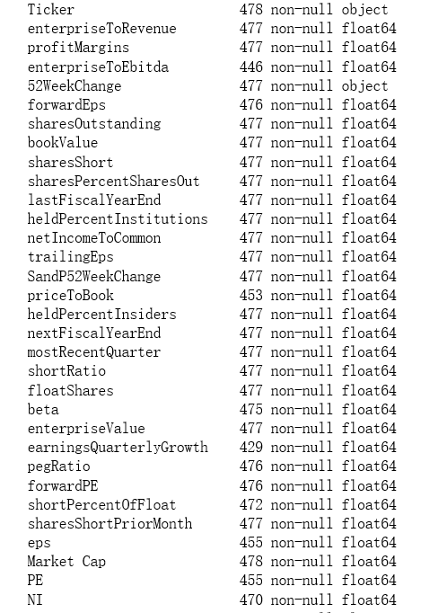
Dealing with missing values

Slide 4

Dealing with missing values
Technical
Features
23 stocks that have missing values.
Drop these 23 stocks
(1008)
Unbalanced
Orders Dataset
1. Drop the same 23 stocks in technical features
2. Impute mean to the rest of missing values
Fundamental
Features
Dynamic-Adjust System:
1. Adjust our quotations based on net position
2. Time lag of 5 ms

Slide 5







Some problems we encountered
Feature Combination
Feature Selection
Feature Engineering: Choose best M features
Fundamental:
EPS, E/D…( 32 )
Model Optimization: Compare N model
CH score
PCA components
If we select stock based on their return, do back test for history data.
Technical:
Close, Open, Volume, High, Low(5)
Silhouette Coefficient
Clustering Results
Feature Combination
Stock Selection
Risk VS Return

Slide 6
How to combine tech & fundamental
Option 1
Ticker | Profit Margin | EPS | … | D1 Close P | D2 Close P | … | D1008 Close P
A |  |  |  | 100 | 101 |  | 99
AAL
AAP
AAPL
Option 2
Ticker | Profit Margin | EPS | … | Close P
A |  |  |  | [100, 101,…,99]
AAL
AAP
AAPL

Slide 7

